Slide 1
DOING BUSIINESS WITH PURDUE
State of Indiana
Division of Supplier Diversity 12th Annual Business Conference
October 7, 2020 1:00 p.m.–2:00 p.m.
Presentation by:
Chris Springer
Manager Strategic Sourcing

Slide 2
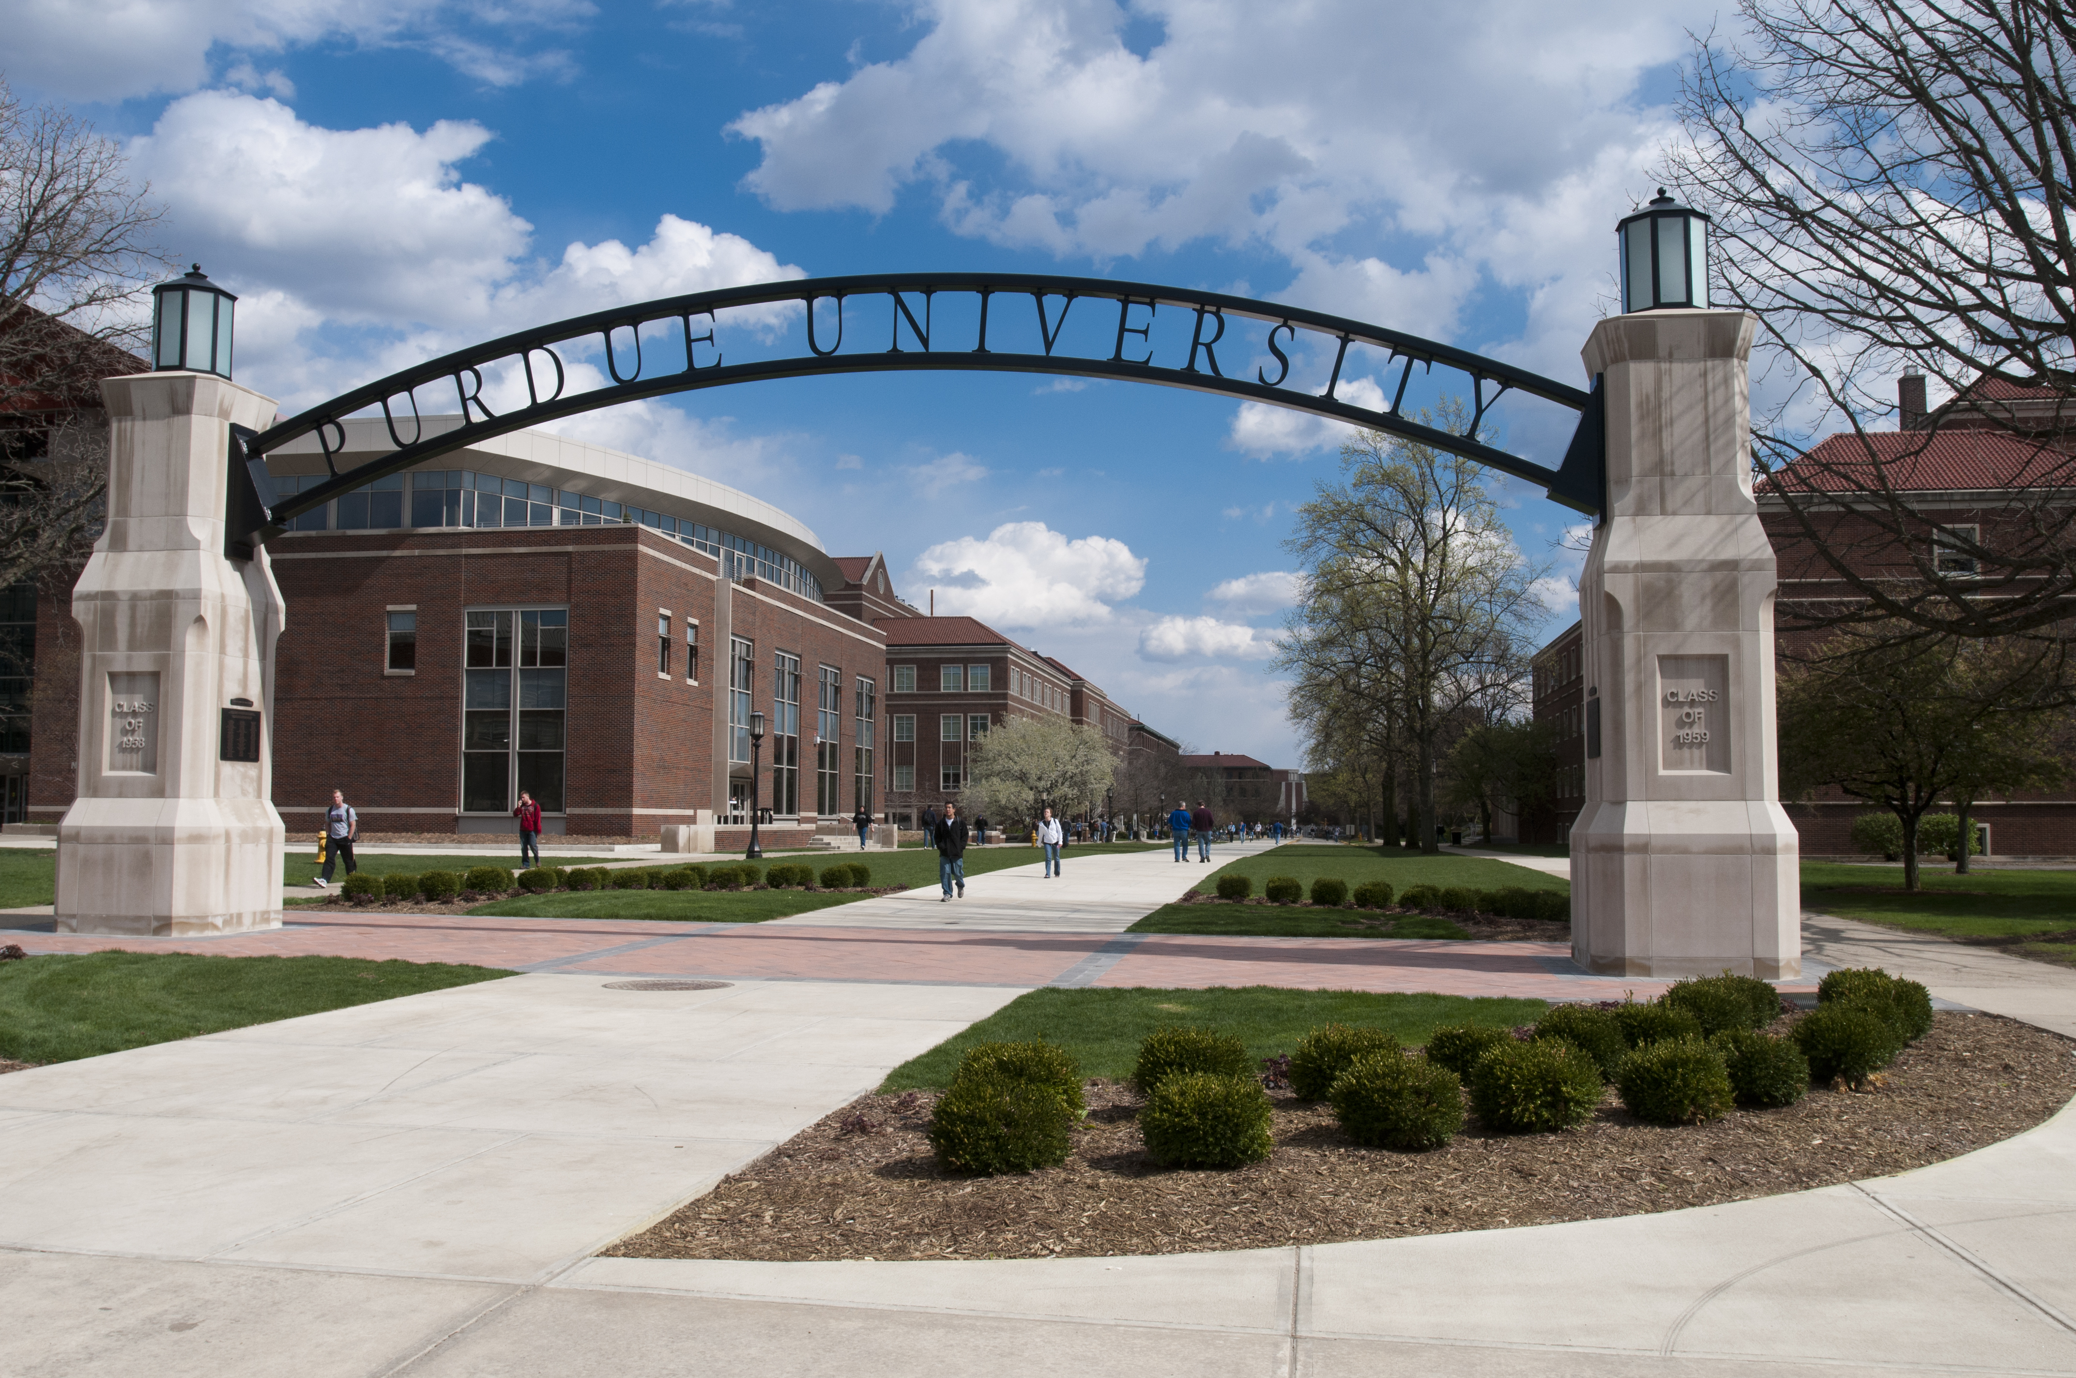

Purdue University
Purdue University is a top public research institution developing practical solutions to today’s toughest challenges.
Ranked the No. 5 Most Innovative University in the United States by U.S. News & World Report, Purdue delivers world-changing research and out-of-this-world discovery.
Committed to hands-on and online, real-world learning, Purdue offers a transformative education to all.
Committed to affordability and accessibility, Purdue has frozen tuition and most fees at 2012-13 levels, enabling more students than ever to graduate debt-free

Slide 3
Our Commitment
Purdue University is committed to being a leader in higher education supplier diversity through:
Exploring new ways to contribute to the establishment, preservation and strengthening of minority-, veteran- and women-owned businesses
Enhancing and growing relationships and contract opportunities
Implementation of automated reporting tools and standardized processes for prime contractors

Slide 4
Our Commitment In Action
Preserve And Strengthen Diversity Owned Business
Implement Standard Reporting Tools And Processes For Prime Contractors
Enhance Relationships And Grow Contract Opportunities
Business Opportunities Availability Postings
System Generated Reporting Reminders
Strategic Supplier Business Review
Outreach Events
Educational Materials
Strategic Plan
Monthly Reporting
Inclusion Standards In Bids And Request For Proposals
State Of Indiana Certification Focused Clinics

Slide 5
University Buying
Suppliers wanting to do business with Purdue must :
    Be registered with the Secretary of State
    Not suspended from doing business with Purdue, State of Indiana and/or the Federal government
    Capital project contractors must be pre-qualified through the State of Indiana. Contractors who are not already pre-qualified should follow the process outlined by the Indiana Department of Administration (www.in.gov/idoa/2486.htm) for future consideration.
Architect and Engineering Firms should call (765) 494-8000 or email adminops@purdue.edu in order to be placed on the contact list for future opportunities.
Purdue has different methods for purchasing products and services based on the type of purchase and estimated price of the project.
To ensure businesses of all demographics are afforded the opportunity to compete for university contracts minority, women or veteran owned suppliers are included in solicitations over $1,000 for goods and services.

Slide 6
University Buying
Small Public Works And Capital Construction Program Projects
Capital Program Management oversees small public works and capital program projects typically valued at more than $150,000.
  Procurement information is available in the ePlanroom portal at https://www.purdue.edu/physicalfacilities/units/capital-program-management/eplanroom.html
  The ePlanroom contains bid documents and reports for all Purdue University campuses, including current and future projects.
  Capital Program Management Office
      Website: https://www.purdue.edu/physicalfacilities/ae-contractor/index.php
      Email: dminops@purdue.edu
      Phone: 765-494-8000.

Slide 7
University Buying
Goods and Services
Procurement establishes system-wide contracts for goods and services and also for department specific needs that exceed $10K.
  Ariba is the University’s eProcurement tool
  Bid Opportunities are posted daily - https://www.purdue.edu/procurement/supplier-info/business-opportunities.php
  Standard inclusion of MBE/WBE/VBE vendors in proposals
  Procurement questions should be addressed to the specific campus contacts
    Purdue West Lafayette pshelpdesk@purdue.edu or (765) 494-7279.
    Purdue Fort Wayne purchase@pfw.edu or (260) 481-6800.
    Purdue Northwest procurement@pnw.edu or (219) 989-2238.
Departments follow small purchasing procedures for requisitions less than $10K
  Minimum of 2 quotes recommended
  Include MBE/WBE/VBE vendors in bids
.

Slide 8
Planned Projects
In response to the COVID-19 pandemic, Purdue has taken extensive actions to minimize the impact to the university. We believe these actions will allow Purdue to weather this pandemic and emerge stronger. Immediate measures have been taken to reduce expenses, including reduction of nonessential spending.
Capital Projects | Prime Contractor
Veterinary Medicine Teaching Hospital | Pepper Construction
Engineering And Polytechnic Gateway –Instructional Space | Shiel Sexton
Hagle Hall - University’s Bands And Orchestras Home | Gilbane
Data Science Building | Projects postponed due to COVID-19 and will be re-assessed by University leadership in Fall 2020.
Child Care Facility
2550 Northwestern Avenue Renovation
Goods and Services
MRO Supplies | Ross Aide Wi-Fi

Slide 9

8/2020
Submit questions to Supplierdiversity@purdue.edu
Notes:
Thank you for your time today.
I hope that you are better educated on the Request For Proposal process and can use the knowledge and tools to build a winning response.
Look for more educational sessions as Purdue continues to leverage the power of sharing knowledge and skills with the aspiration of increasing principal contracts with women, minority and veteran owned businesses, driving economic development, business growth, and job creation.
If you have questions please submit them to supplierdiversity@purdue.edu.
You may now close the internet browser window.

Slide 10
Thank You

